Slide 1


7
6
5
4
WEATHER Desktop NOTIFICATION
USING Python
-TEAM 1
3
2
1

Slide 2

INTRODUCTION
WORKING ALGORITHM OF THE PROGRAM
This Python project sends live weather reports as desktop notifications. This information sent includes temperature, pressure , humidity and a description if any
1

Slide 3
MODULES USED
Requests
BeautifulSoup4
Json
Urlopen
ToastNotifier
Schedule
time
2

Slide 4
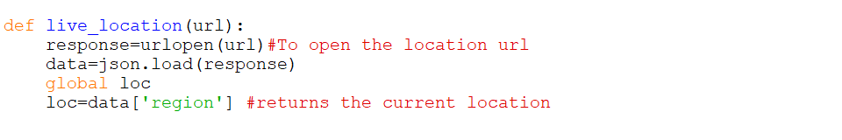
TO GET LIVE LOCATION
Here the current location was stored in “loc” variable
And “json” library module is used for the function to get live location.
3

Slide 5
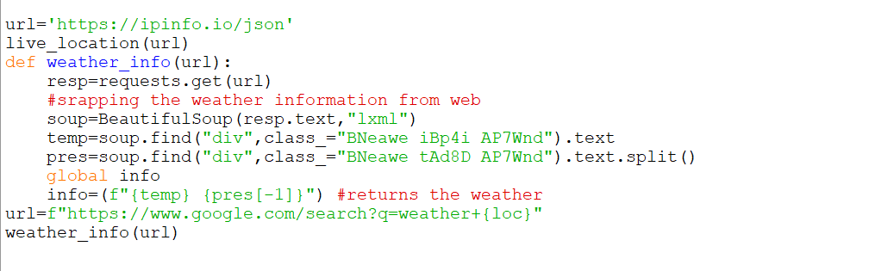
4
To Get Weather from WEB
Here, the variable “url” takes the web location and then scrap the information of weather. The weather details are stored in variable “Weather_info”
Here BeautifulSoup4 module is used
4

Slide 6
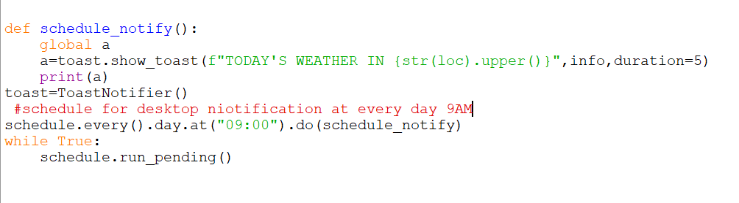
SCHEDULE WEATHER NOTIFICATION EVERYDAY:
5
•

Slide 7
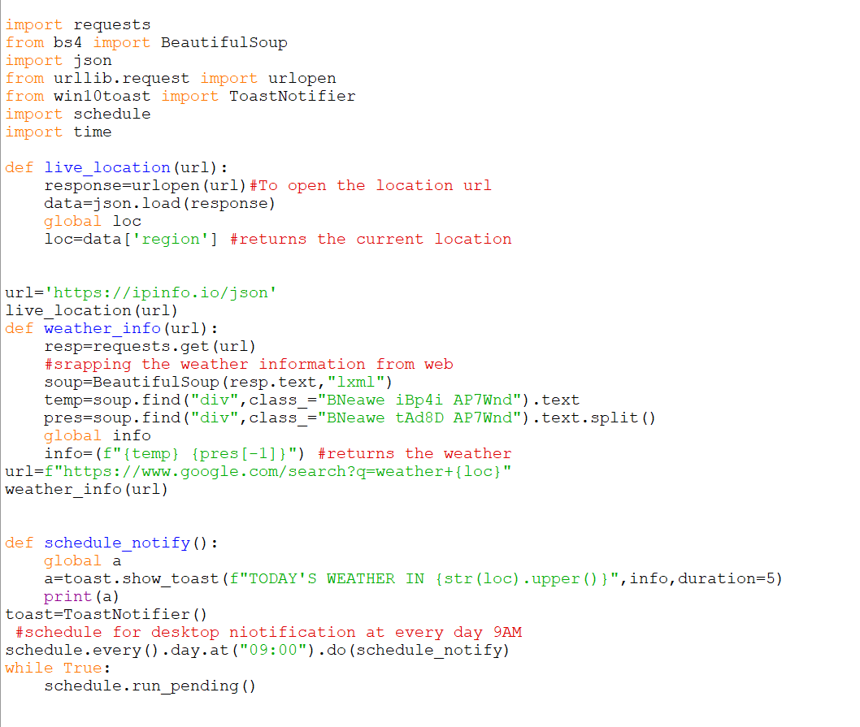
PYTHON PROGRAM:
6

Slide 8
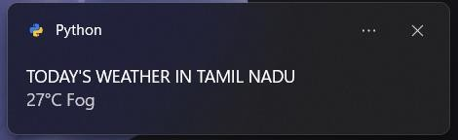
We can see a daily notification by python about today's weather
OUTPUT:
7
HERE IS THE SAMPLE OUTPUT,
ABOUT THE OUTPUT IWHICH IS GOING TO BE DISPLAYED ON THE SCREEN DAILY.

Slide 9
THANK YOU!

